Slide 1


Data Cleaning Techniques In Excel

Slide 2


Introduction
Data cleaning, also known as data cleansing or data scrubbing, is a fundamental process in data preparation.
It is the process of identifying and correcting errors, inconsistencies, and inaccuracies in datasets to improve data quality and integrity.
Data cleaning is a critical step in the data analysis process

Slide 3

Key Aspects of Data Quality:
❖ Accuracy: Data accurately reflects the real-world scenario.
❖ Completeness: Data is comprehensive and lacks missing values.
❖ Consistency: Data is uniform and follows a standard format.
❖ Relevance: Data is relevant to the analysis or decision-making process.
❖ Timeliness: Data is up-to-date and reflects the current state of affairs.

Slide 4

Why is Data Cleaning Necessary?
Accurate Analysis: Clean data ensures accurate and reliable analysis, leading to better decision-making.
Avoiding Errors: Incorrect or inconsistent data can lead to errors in calculations and interpretations.
Enhancing Trust: Clean data builds trust in the conclusions drawn from the data.
Compliance: Some industries, like finance or healthcare, have strict data quality standards for compliance.

Slide 5
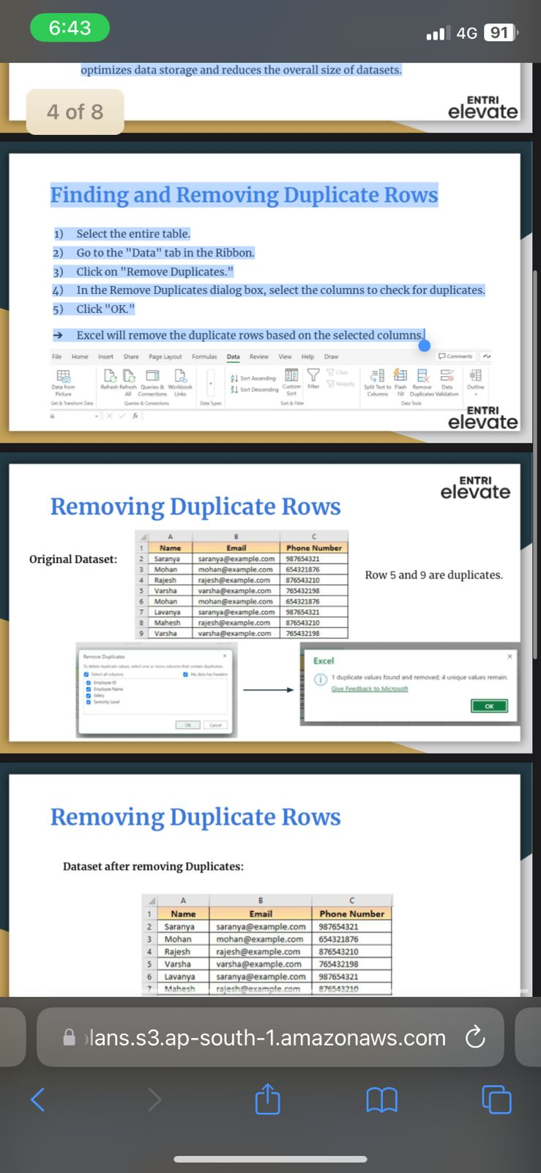
Removing duplicates in Data
Dealing with duplicates is a critical aspect of data cleaning, ensuring that the dataset is free from inaccuracies and bias, and that it accurately represents the phenomena that is been analyzed.
Finding and Removing Duplicate Rows
1) Select the entire table.
2) Go to the "Data" tab in the Ribbon.
3) Click on "Remove Duplicates.“
4) In the Remove Duplicates dialog box, select the columns to check for duplicates.
5) Click "OK.“
➔ Excel will remove the duplicate rows based on the selected columns.

Slide 6
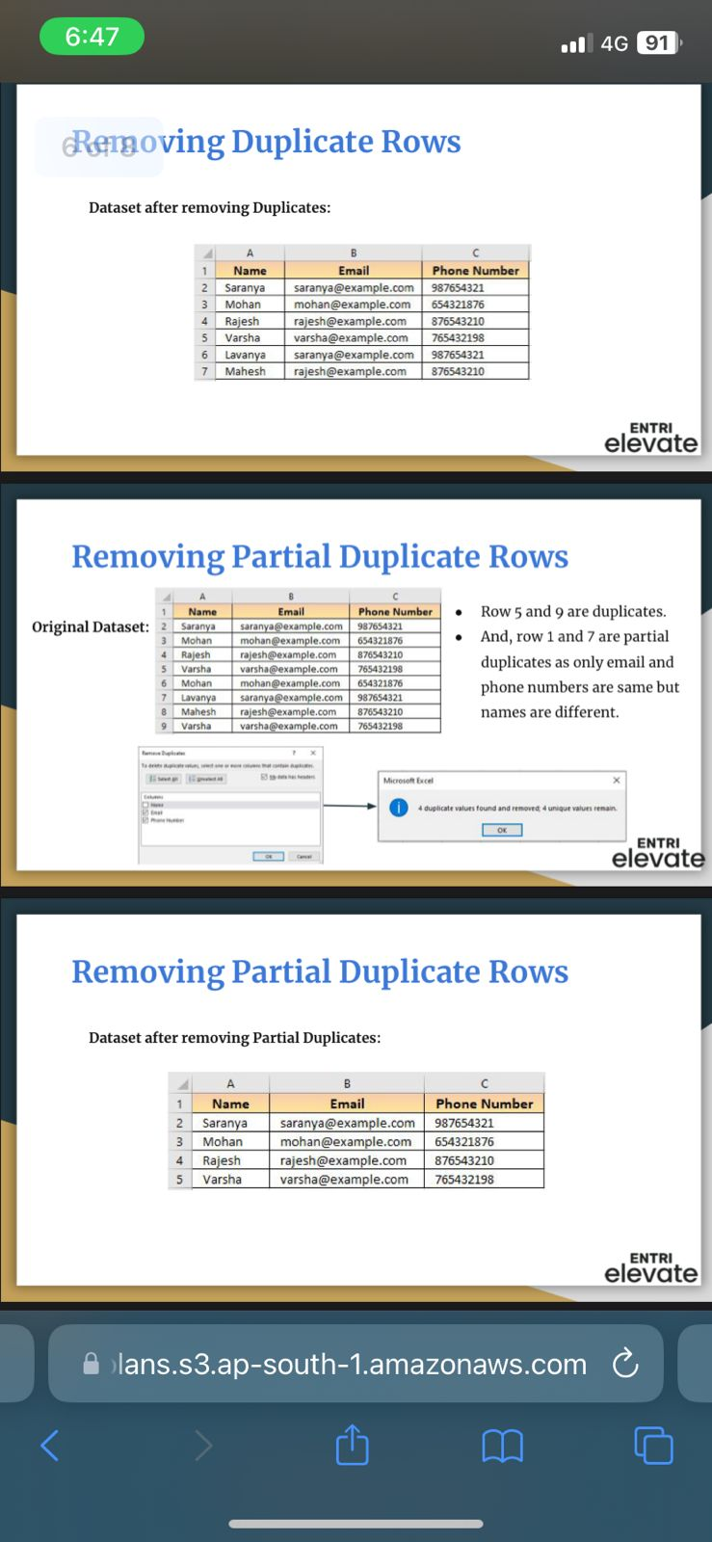

Remove partial duplicate rows

Slide 7
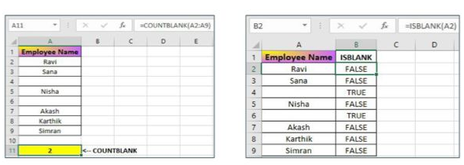
Identifying missing values
Blank Cells:
Empty cells in a column may indicate missing values.
★ Excel Functions for the Identification:
➔ COUNTBLANK:
=COUNTBLANK(range)
◆ Counts the number of blank cells in a specified range.
➔ ISBLANK: =ISBLANK(value)
◆ Returns TRUE if a cell is empty, else returns FALSE if it contains anydata, including spaces.

Slide 8

Handling missing values
Imputation:
For numerical columns, you can impute the mean or median.
For categorical columns, you may use the mode (the most frequent category).
Deleting Rows or Columns:
If the missing values don't significantly impact the analysis, consider deleting the corresponding rows or columns based on the severity of missing values.
Use caution, as this approach can result in the loss of potentially valuable information.

Slide 9
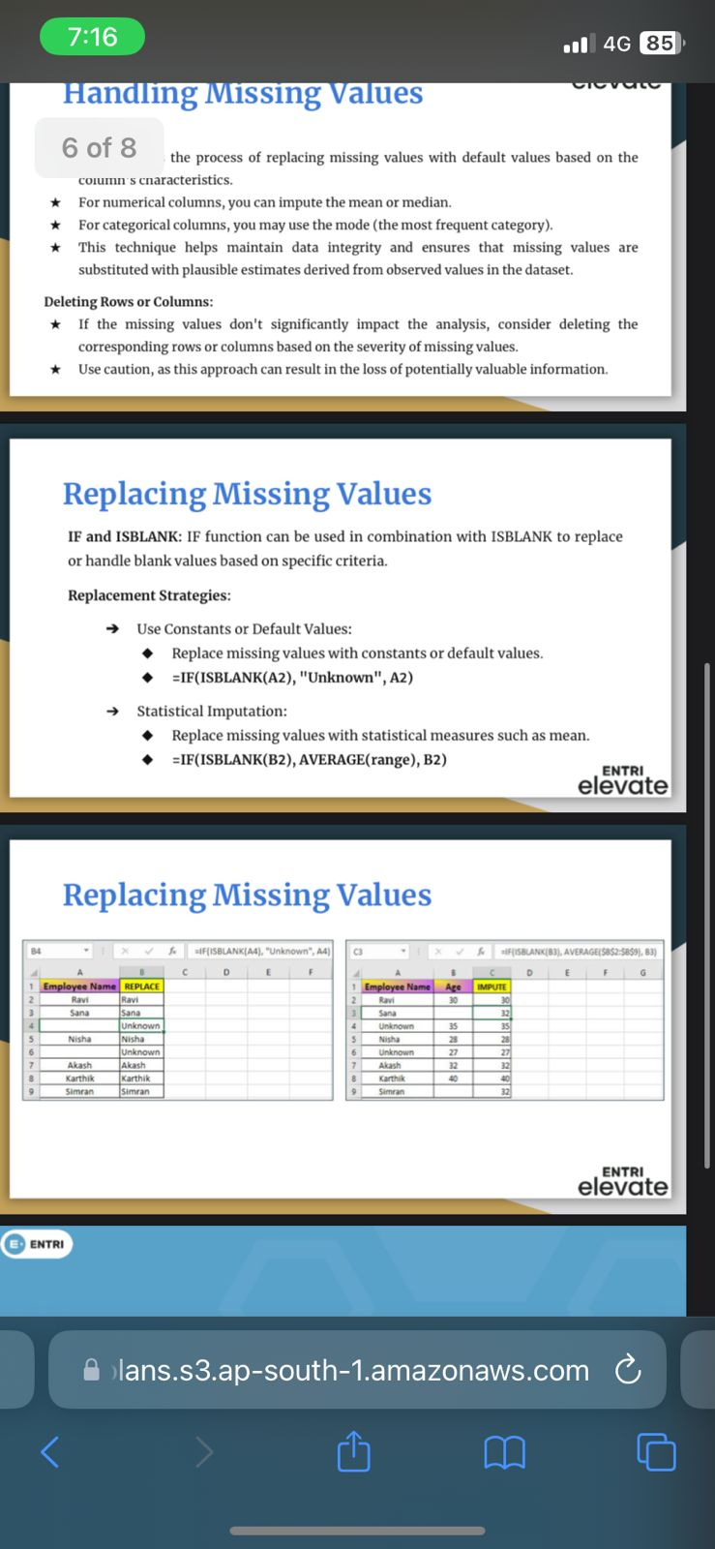
Replacing missing values
IF and ISBLANK: IF function can be used in combination with ISBLANK to replace or handle blank values based on specific criteria.
Replacement Strategies:
➔ Use Constants or Default Values:
◆ Replace missing values with constants or default values.
◆ =IF(ISBLANK(A2), "Unknown", A2)
➔ Statistical Imputation:
◆ Replace missing values with statistical measures such as mean.
◆ =IF(ISBLANK(B2), AVERAGE(range), B2)

Slide 10
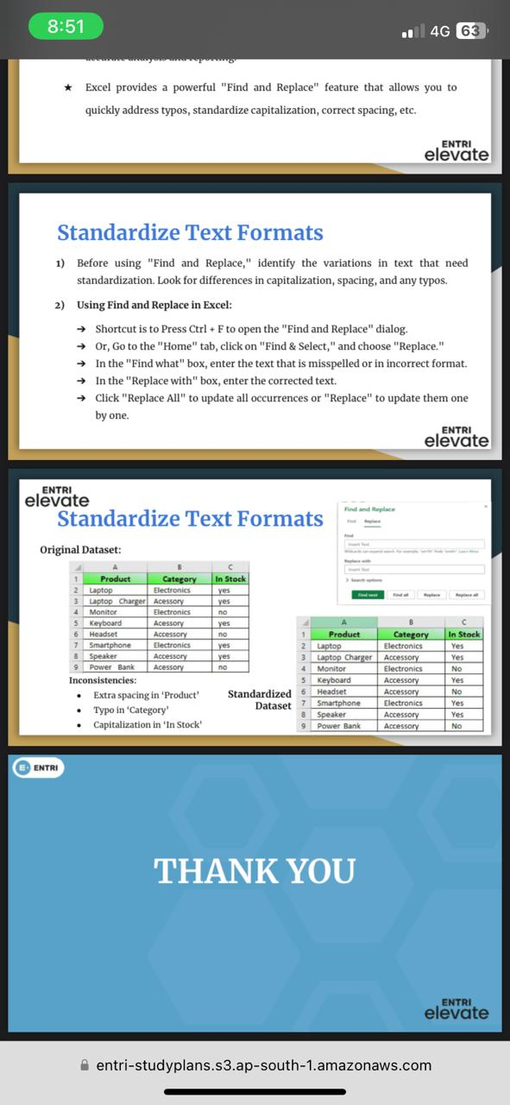
Correcting inconsistent data
Inconsistent data, including variations in text formats, typos, and misspellings, can hinder analysis and create challenges in data management.
Excel provides a powerful "Find and Replace" feature that allows you to quickly address typos, standardize capitalization, correct spacing, etc.
1) Before using "Find and Replace," identify the variations in text that need standardization. Look for differences in capitalization, spacing, and any typos.

Slide 11

Standardize Text Formats
Before using "Find and Replace," identify the variations in text that need standardization. Look for differences in capitalization, spacing, and any typos.
2) Using Find and Replace in Excel:
➔ Shortcut is to Press Ctrl + F to open the "Find and Replace" dialog.
➔ Or, Go to the "Home" tab, click on "Find & Select," and choose "Replace.“
➔ In the "Find what" box, enter the text that is misspelled or in incorrect format.
➔ In the "Replace with" box, enter the corrected text.
➔ Click "Replace All" to update all occurrences or "Replace" to update them oneby one.

Slide 12
Correcting inconsistent data
Inconsistent data, including variations in text formats, typos, and misspellings, can hinder analysis and create challenges in data management.
Excel provides a powerful "Find and Replace" feature that allows you to quickly address typos, standardize capitalization, correct spacing, etc.
1) Before using "Find and Replace," identify the variations in text that need standardization. Look for differences in capitalization, spacing, and any typos.

Slide 13
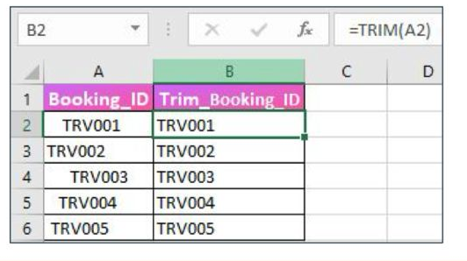
Removing unnecessary characters and spaces
Cleaning data includes the removal of unnecessary characters and spaces to enhance consistency and prepare it for analysis.
TRIM Function
★ TRIM Function removes leading and trailing spaces from a text string, leaving only single spaces between words.
★ Syntax: =TRIM(text)
★ Example: =TRIM(" Hello World ") returns "Hello World" by removing extra spaces.

Slide 14
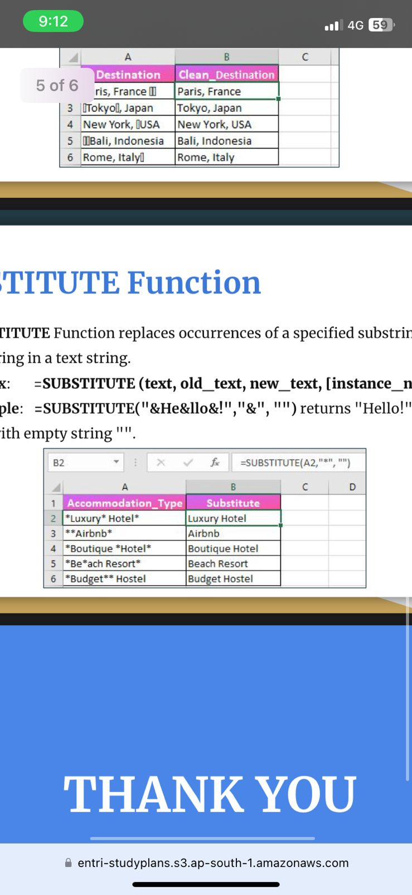
CLEAN Function
CLEAN Function removes non-printable characters from a text string. Useful for cleaning up text imported from external sources.
Syntax: =CLEAN (text)
Example: =CLEAN("H⍰ello") returns "Hello" by removing the non-printable character. SUBSTITUTE Function
★ SUBSTITUTE Function replaces occurrences of a specified substring with another substring in a text string.
★ Syntax: =SUBSTITUTE (text, old_text, new_text, [instance_num])
★ Example: =SUBSTITUTE("&He&llo&!","&", "") returns "Hello!" by replacing"&" with empty string "".

Slide 15
Conclusion
Data cleaning is a vital step in the data analytics process, and using Excel to clean data can help ensure the accuracy and reliability of your results. By eliminating unnecessary values, you can streamline your dataset, making it more manageable and focused on the relevant data points, thus leading to more accurate and reliable insights.

Slide 16
THANKYOU IF YOU HAVE ANY QUESTIONS thahliyamist@gmail.com

